Slide 1
Kieran/Mike – Use Cases and Case Studies
References and awards
Direct model
Indirect model
Merchants
Telco
Gaming
Legislative changes creating opportunity
FIs – Acquirers; PSPs

Slide 2




ACI ReD Shield® Case Studies
The results!
Crew Clothing
Aegean Airlines
Voyages-SNCF
Reduced deny rate by 12% to 3%
Over the first 12 months of the contract, ACI helped stop 97% of confirmed fraud, saving over €3,000,000
Over the last 3 years reduced fraud rate on both domestic and cross-border transactions by 66%, delivering a smoother customer experience and protecting brand reputation
Reduced fraud rate from 1% to 0.5%

Slide 3
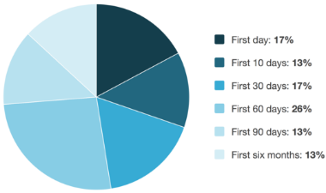
Don’t Take Our Word for It
ACI Red Shield® customer research
Note: 7 people answered “I don’t know/not applicable.” Their responses have been excluded from this chart, and from the sample size.
How long after you deployed the solution did you begin seeing fraud management benefits? (i.e., reductions in losses, improvements in efficiency/resources or both)?
OUT OF 23 ACI customers surveyed
47% of customers experienced fraud management benefits from ACI Red Shield in the first 30 days
73% in the first 60 days
86% in the first 90 days
100% saw benefit in the first 6 months
Source: TechValidate survey of 23 users of ACI ReD Shield.

Slide 4


Awards and Accolades
Security Innovation of the Year 2018 Awarded to ACI for the real-time fraud management and adaptive machine learning capabilities of its payments risk management solutions.
Best ID, Security and Anti-Fraud Solution 2018 International Award 2017 UP® eCommerce Payments™ solution
“ACI ReD Shield helped turn a $4M annual fraud loss into a less than $250K annual fraud loss over the last four years. It allowed us to implement an automated fraud prevention program without having to create a manual review team and process.”
IT Systems Analyst, Large Enterprise Food Company
“With implementation of the product level detail, we’ve been able to stop over 95% of losses on our high-risk products. We’ve seen our chargebacks fall dramatically.”
Fraud Analyst, Large Retailer
“The ACI risk analyst team are complete rock stars and incredibly talented. We would be lost without them.”
Director of Fraud, Large Enterprise Consumer Products Company
TVID: 379-19C-F50
TVID: 63C-C96-67C.
TVID: D47-52C-E8D

Slide 5
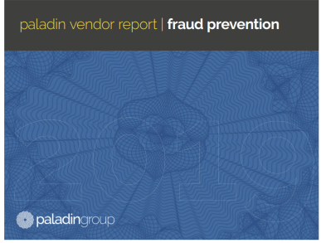
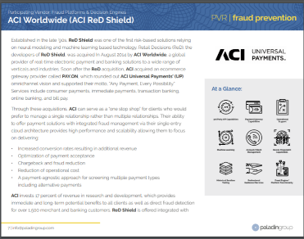
Paladin Vendor Report | Fraud Prevention
View the full report here
“ACI ReD Shield is a real-time, machine learning fraud management solution combined with a series of real-time alerts and near-real-time dashboards. Fraud strategies are modeled to the requirements of the eCommerce client needs.”
Paladin Vendor Report 2019 | Fraud Report
Notes:
file:///C:/Users/shepherdc/Downloads/The%202019%20Paladin%20Fraud%20Vendor%20Report%20-%20ACI%20Summary.pdf
“ACI can serve as a “one stop shop” for clients who would prefer to manage a single relationship rather than multiple relationships. Their ability to offer payment solutions with integrated fraud management via their single entry cloud architecture provides high performance and scalability allowing them to focus on delivering:
Increased conversion rates resulting in additional revenue
Optimization of payment acceptance
Chargeback and fraud reduction
Reduction of operational cost
A payment-agnostic approach for screening multiple payment types including alternative payments

Slide 6
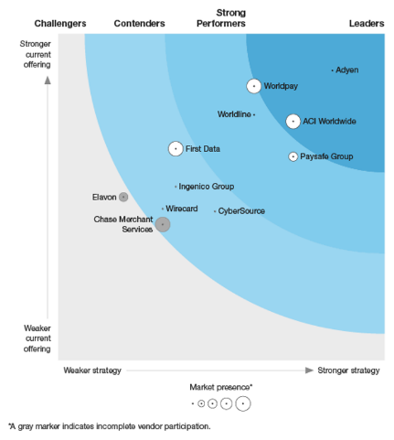
“ACI Worldwide Provides Vast Global Reach with Superior Flexibility.”
The Forrester Wave™: Global Merchant Payment Providers, Q3 2018
“ACI is a best fit for retailers that want a global ‘payments integration hub’ that provides maximum flexibility to manage multiple acquirers, payment methods and technology providers.”
The Forrester Wave™: Global Merchant Payment Providers, Q4 2018 Report

Slide 7
Machine Learning Models Using Consortium Data
Model performance use case – Retail
ABOUT
CHALLENGE
SOLUTION
Leverage collective positive (good) data and fraud data across multiple retailer portfolios
Including more than 100 million cards over 250 million transactions
Online fraud is pervasive among retailers in today’s increasingly digital world
Fraud losses in excess of $200M
Average fraud loss per transaction >$250
ACI segment model designed to achieve higher fraud detection rates with lower false positive rates
The model uses the history from all consumer transactions across ACI’s retailer consortium data set
Greater than $100M in fraud detected by ACI segment model
Model detects approximately 50% of all potential fraud transactions
Model false positive ratio less than 7:1
RESULTS
Notes:
Based on ReD Retailer Consortium Data Retail"

Slide 8
Detecting Fraud in the Gaming Sector
Model performance use case – Gaming
ABOUT
CHALLENGE
SOLUTION
Leverage gaming client data across various global geographies
Supporting immediate purchase of digital downloads
Real-time accept or deny decisions focused on extremely low false positive rates
High volumes of low-value transactions across various channels (e.g., console, online and mobile) make it harder to distinguish fraud
High season (e.g., Christmas) and gaming release schedules provide an increased opportunity for fraudsters
BOT attacks and account takeovers driving the majority of fraud for this sector
Sector models developed using ACI gaming data with geographic factors
Focus on chargebacks to alleviate customer refund requests
Identify “dormant” fraudsters who may wait to attack (e.g., not always a “new player” problem)
Sector models identified up to 43% of chargeback fraud loss
Sector models detected up to 28% of chargeback fraud
Nearly $10M in fraud loss saved annually
RESULTS
Notes:
Based on ReD Shield "Gaming" Consortium Data

Slide 9
Consortium Approach to Travel
Model performance use case – Travel
ABOUT
CHALLENGE
SOLUTION
Leverage collective fraud data across multiple travel clients from the airline, train, hotel and online travel agents (OTA) verticals
Evaluating approximately 25 million accounts, more than 50 million transactions and over 120,000 fraudulent transactions
Travel purchases tend to have higher average transaction values (e.g., plane tickets, train tickets, hotel stays, travel/vacation packages, etc.) with lower frequency
Average fraud loss is $500 per transaction
Sector model designed to identify high-value transaction types
Pooling of travel data facilitates a stronger detection system across this sector
Travel sector model false positive rate is 12:1
Model detected more than 45% of fraudulent transactions
Fraud amount alerted 60% total fraud loss
More than US$35M fraud losses detected
RESULTS
Notes:
Based on ReD Shield "Travel" Consortium Data

Slide 10
Stream Analytics Engine in Action
Improving revenue and the bottom line
Telco Results
Retail Results
Gaming Results
Five rule amendments to target newer customers only has delivered:
20% increase on revenue in one channel in seven months
Positive impact on customer lifecycle
Amending the top six hitting rules has delivered:
4,427 fewer challenged transactions
3,264 fewer cancelled transactions
Total value of cancelled transactions £2,190,326 in only one month
Stream Analytics Engine's strategy enhancements have delivered:
A 59% improvement in accept rates during the holiday season equating to $245K per month
Additional monthly fraud savings of $100K
A 28% improvement in response time – enhancing efficiency and the customer experience
Source: ACI Data
Notes:
Source: file:///C:/Users/shepherdc/Downloads/ACI%20ReD%20Shield%20Stream%20Analytics%20Engine%20-%20infographic%20-%20US%20(1).pdf

Slide 11
Key Points – Selling to Retail
Retail Strategy Optimization
Strong data mapping
Product, delivery, sales channels, device/IP above standard payments/customer data
Order review (with Case Manager/tieback)
Assign reviews to specific agents and workflows with automatic updates to all systems
Positive profiling strategy
Ensure whitelisting and profile good OVER bad – through positive profiling intelligence
3D Secure (3DS) and post-authorization screening
Track conversion loss on 3DS and ensure payments intelligence in rules (CVV AVS 3DS response)
Custom LISTS/IF statements
Nested rules through CONDITIONS and FEATURES to ensure rule applies correctly (false positives)
Leverage consortium (fraud/models/positive profiles)
Remove SILO approach and reduce exposure to risk by converting data to intelligence
Notes:
Source: file:///C:/Users/shepherdc/Downloads/ACI%20ReD%20Shield%20Stream%20Analytics%20Engine%20-%20infographic%20-%20US%20(1).pdf

Slide 12
Key Points – Selling to Gaming
Gaming Strategy Optimization
Accept/deny real time – Challenge in silent
Utilize challenge condition for reviewing potential fraud – while accepting in LIVE mode
Always accept strategy
Ensure whitelisting and profile good OVER bad – through positive profiling intelligence
Profiling in business intelligence
Due to high margins (post R&D) per txn, it is critical to monitor and profile offline for RISK
Custom LISTS/IF statements
Nested rules through CONDITIONS and FEATURES to ensure rule applies correctly (false positives)
Leverage consortium (fraud/models/positive profiles)
Remove SILO approach and reduce exposure to risk by converting data to intelligence
TPS
Ensure platform can handle huge volumes at peak periods

Slide 13
Key Points – Selling to Telco
Telco Strategy Optimization
Custom LISTS/IF statements
Nested rules through CONDITIONS and FEATURES to ensure rule applies correctly (false positives)
Profiling in business intelligence
Due to high margins (post R&D) per txn, it is critical to monitor and profile offline for RISK
Separate rules per channel – Top-up/credit/retail
Understand exposure, data capture and process per channel and LIABILITY
Leverage customer data across channels for positive profiling – ARPU/churn/false positives
Leverage consortium (fraud/models/positive profiles)
Remove SILO approach and reduce exposure to risk by converting data to intelligence
RCF and enhanced response
Push data intelligence from RISK to operations, credit scoring, network systems

Slide 14
Key Points – Selling to PSPs
PSP Strategy Optimization
With theme RFP/growth driver
Majority of merchant requirements/differentiations sit within fraud solutions
Revenue per transaction
Potential to double PPT or be more creative on pricing deals
Competition and commoditisation
More and more core services in payments are table stakes with fraud as a differentiator
Strategies/solutions for entire customer base
Single technical and API to service 100% of customers in appropriate way
Integrated and ownership of customer experience
Potential dangers associated with merchants having multiple contracts and relationships
Remove it from source risk – Focus on core platform
Maintain investment in gateway functionality

Slide 15
Partner Models to Support All Merchants
Fraud Management Services | Sector | Intermediate** | Custom
Industry ACI ReD Shield Setup | ü | ü
Industry ACI ReD Shield Setup – Custom thresholds |  | ü
Fully Customized ACI ReD Shield Setup |  |  | ü
Challenge Responses for Manual Reviews |  | ü | ü
CSI – Transaction Reviewing Portal |  | ü | ü
Global Consortium Database Checks | ü | ü | ü
IP and Device Fingerprinting* | ü | ü | ü
Black/Whitelisting through CSI |  | ü | ü
Case Management for Queues |  | ü | ü
Single Tie-Back Message and Destination |  | ü
Custom Tie-Back Message and Destination |  |  | ü
Standard CSI Reporting |  | ü | ü
ACI ReDi Business Intelligence |  | ü | ü
Risk – Service Reviews for PSP | ü | ü | ü
Risk – Service Reviews for Merchant |  |  | ü
Standard PSP Fraud Support via PSP | ü | ü | ü
Standard PSP Fraud Support Merchant Direct |  |  | ü
ACI Risk Team Support |  |  | ü
*Device Fingerprinting on request via third party ** Intermediate – rules, case manager, analysis done by PSP/merchant – not through ACI
Notes:
This table describes the modules available
Naming is internal only!!!!!
Ultimate message here is that we service 100% of customers needs into one of the three options

Slide 16
Key Points – Selling to Travel
Travel and Transit Strategy Optimization
Profiling
Know good customer behavior and safeguard VIP customers
Consortium data
Leverage global good and bad data points for black/whitelisting
Reporting in ACI ReDi
Near-real-time access to all KPIs that drive risk and inefficiencies in process
List management
Ensure custom lists are implemented on all data points
Machine learning
Utilize intelligence and profiling from ML model technology

Slide 17
Key Points – Selling PSD2/SCA
PSD2/SCA Strategy Optimization
Reporting and audit
Regulators will hold merchants, acquirers and issuers to fraud level achievements
Extra payments step required
Fraud was pre- or post- authorization – now need decision pre-authentication
Merchants can deploy exemptions from acquirers/issuers
Less than 30 euro, TRA (transaction risk analysis)
Exemptions depend on fraud rates
Merchants should hold acquirers accountable
Not an excuse to turn off fraud screening
Premise is to enhance fraud – not reduce fraud

Slide 18
Payment Flows Today with 3DS 1.0
Key Issue Today
PSP
PSP presents checkout page – payment entered
PSP 3DS MPI/ISSUER
Issuer defines 3DS steps: dynamic option for most issuers
Issuer offers dynamic 3DS with no consumer intelligence
Merchant does little fraud screening as it is liability shifted. Result is that no one manages fraud – and fraud increases
PSP/MERCHANT/VENDOR
Fraud screening pre/post-auth
ACQUIRER/ISSUER
Transaction goes to AUTH as authenticated or not
Key Considerations
Acquirer doesn’t influence authentication today, but has ownership of exemptions under SCA/PSD2 (along with issuers)
More rules, data and exemptions within future authentication under PSD2
ACQUIRER/ISSUER
Acquirer approval based on call to issuer
PSP
Checkout approved or declined
Notes:
Important to establish purpose of a fraud management tool.
In 98% of cases it will refer to 4 business benefits:
Converting revenue is often the most important as fraud can decline a high% of revenue ready to make purchase
Growth depends on the merchants strategy – often growth is new countries but can also relate to additional services (click and collect, same day delivery, new payment types
Reduce Chargebacks – self explanatory and core to what ReD Shield does
Reduce OPEX – this relates to IT costs, Project costs and cost of manual review teams or fraud analytics teams for starters
This is more an introductory slide and important to establish there current issues (which of 4 is most important)

Slide 19
Payment Flows with PSD2 SCA and 3DS 2.0
Acquirer needs to own checkout to define exemptions – reduce friction and improve conversion under rules of PSD2/TRA/SCA
PSP
PSP presents checkout page – payment entered
PSP 3DS MPI/ISSUER
Issuer defines 3DS steps: dynamic option for most issuers
PSP/MERCHANT/VENDOR
Fraud screening pre/post-auth
ACQUIRER/ISSUER
Transaction goes to AUTH as authenticated or not
SCA Exemption Rules Engine – ACI ReD Shield
ACQUIRER/ISSUER
Acquirer approval based on call to issuer
PSP
Checkout approved or declined
Merchant still needs to own fraud in pre- or post-auth, irrespective of SCA results
Notes:
Important to establish purpose of a fraud management tool.
In 98% of cases it will refer to 4 business benefits:
Converting revenue is often the most important as fraud can decline a high% of revenue ready to make purchase
Growth depends on the merchants strategy – often growth is new countries but can also relate to additional services (click and collect, same day delivery, new payment types
Reduce Chargebacks – self explanatory and core to what ReD Shield does
Reduce OPEX – this relates to IT costs, Project costs and cost of manual review teams or fraud analytics teams for starters
This is more an introductory slide and important to establish there current issues (which of 4 is most important)

Slide 20
Session questions?
What % of Red Shield customers saw KPI improvements within 30 days?
Name 2 Optimisation areas for TRAVEL?
Name 3 add-ons between BESPOKE & INTERMEDIATE propositions?
Who can define SCA exemptions? Where does it need to be deployed?
How much fraud as ACI saved Aegean Airlines in past 12 months?
Notes:
Important to establish purpose of a fraud management tool.
In 98% of cases it will refer to 4 business benefits:
Converting revenue is often the most important as fraud can decline a high% of revenue ready to make purchase
Growth depends on the merchants strategy – often growth is new countries but can also relate to additional services (click and collect, same day delivery, new payment types
Reduce Chargebacks – self explanatory and core to what ReD Shield does
Reduce OPEX – this relates to IT costs, Project costs and cost of manual review teams or fraud analytics teams for starters
This is more an introductory slide and important to establish there current issues (which of 4 is most important)

